Slide 1
International Harvest Festival
10/24/2017

Slide 2
Mid-Autumn Festival
Falling on the 15th day of the 8th month according to the Chinese lunar calendar, the Mid-Autumn Festival is the second grandest festival in China after the Chinese New Year. It takes its name from the fact that it is always celebrated in the middle of the autumn season. The day is also known as the Moon Festival, as at that time of the year the moon is at its roundest and brightest.

Slide 3
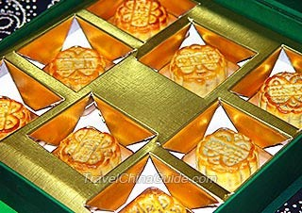
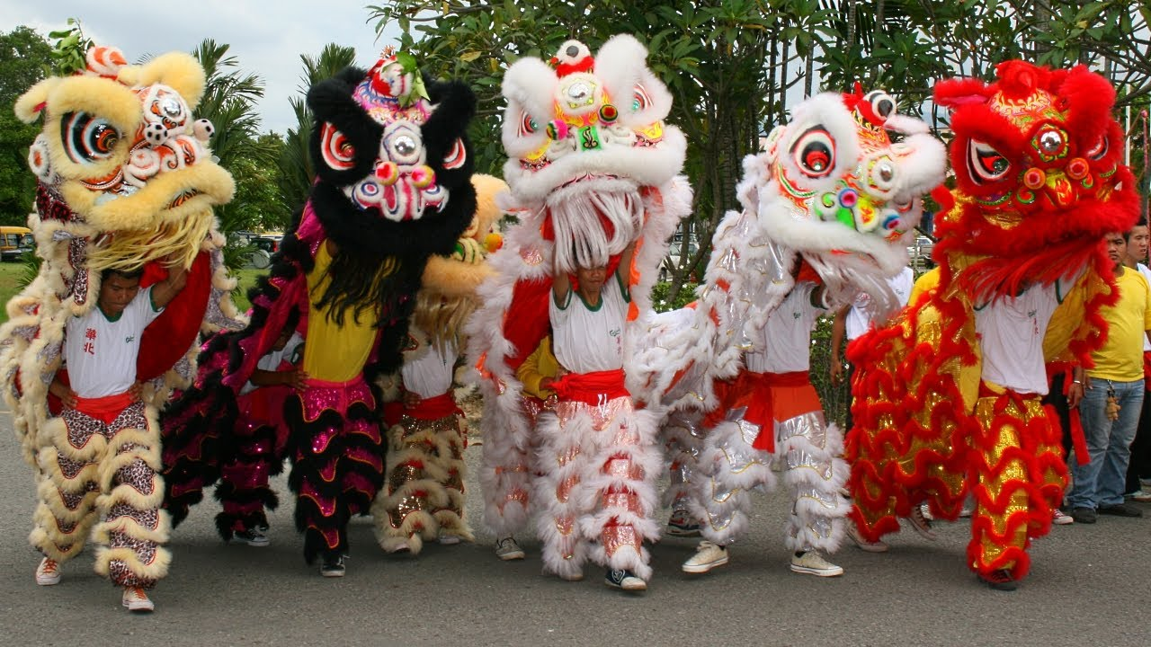
Customs:
Appreciate the full moon
Eat moon cakes
Lanterns
Dragon and lion dances

Slide 4
The Lion Dance
The Lion Dance

Slide 5
What other countries celebrate it?
The Moon Festival, the Mid-Autumn Festival, the Harvest Festival--these are different names for the same celebration that takes place in China, Korea, Vietnam, and other countries. Originally arising out of the rice-growing cycle, this autumn festival was once a day of thanksgiving for the rice harvest.

Slide 6
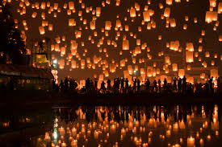
diwali

Slide 7
What is Diwali?
Diwali means “rows of lighted lamps”, is a Hindu-originated festival celebrated in India and by the Indian diaspora. During the five-day celebration –also know as the festival of lights- clay lamps known as diyas are lit to signify the victory of good over evil, according to the Hindu America Foundation.

Slide 8
Hindus interpret the Diwali story based on where they live, according to National Geographic. In northern India, they mark the story of King Rama's return to Ayodhya after he defeated Ravana by lighting rows of clay lamps. In southern India, people celebrate it as the day Lord Krishna defeated the demon Narakasura. In western India, the festival marks the day Lord Vishnu, one of the main gods of the Hindu trinity, sent the demon King Bali to rule the nether world.

